Slide 1
Chapter Eight
Local Area Networks: Part II
Data Communications and Computer Networks: A Business User’s Approach
Eighth Edition
© 2016. Cengage Learning. All Rights Reserved.

Slide 2
After reading this chapter, you should be able to:
Compare and contrast wireless LANs to wired LANs
Identify the main functions of network operating systems
Identify the basic features and contributions of one of the first network operating systems: Novell NetWare
Compare and contrast the Windows Server family, Unix, Linux, and Mac OS X Server network operating systems
Data Communications and Computer Networks: A Business User's Approach, Eighth Edition
© 2016. Cengage Learning. All Rights Reserved.

Slide 3
After reading this chapter, you should be able to (continued):
Recognize the importance of the network server and the different types of network servers available
Identify the different levels of RAID
Identify common examples of network utility software and Internet software
Enumerate the various components of software licenses
Identify the different types of support devices commonly found on local area networks
Data Communications and Computer Networks: A Business User's Approach, Eighth Edition
© 2016. Cengage Learning. All Rights Reserved.

Slide 4
Wireless Ethernet
Not really a specific topology
  Workstation in a wireless LAN can be anywhere as long as it is within transmitting distance to an access point
Several versions of IEEE 802.11 standard define various forms of wireless LAN connections (we’ll take a look at these versions in a little bit)
Data Communications and Computer Networks: A Business User's Approach, Eighth Edition
© 2016. Cengage Learning. All Rights Reserved.

Slide 5
Wireless Ethernet (continued)
Two basic components necessary:
  Client radio
    Usually a PC card with an integrated antenna installed in a laptop or workstation
  Access point (AP)
    An Ethernet port plus a transceiver
Access point acts as a bridge between the wired and wireless networks and can perform basic routing functions
Workstations with client radio cards reside within Basic Service Set, while multiple basic service sets create an Extended Service Set
Data Communications and Computer Networks: A Business User's Approach, Eighth Edition
© 2016. Cengage Learning. All Rights Reserved.

Slide 6
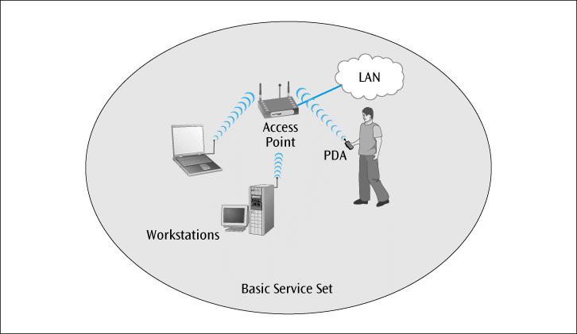
Wireless Ethernet (continued)
Figure 8-1
A single-cell wireless LAN configuration
Data Communications and Computer Networks: A Business User's Approach, Eighth Edition
© 2016. Cengage Learning. All Rights Reserved.

Slide 7
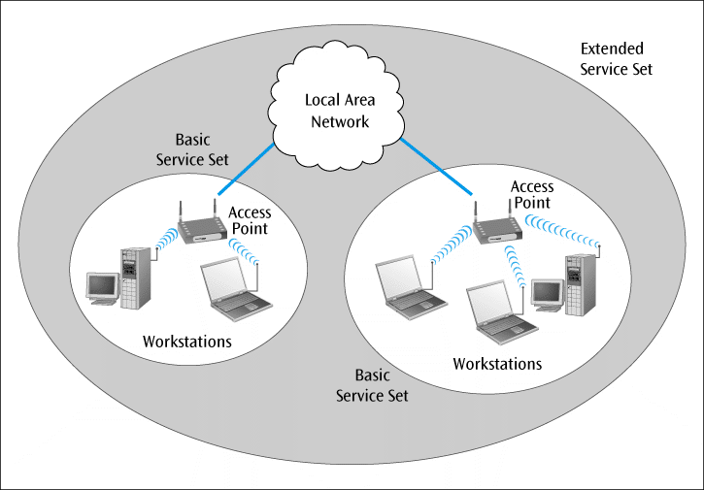
Wireless Ethernet (continued)
Figure 8-2
A multiple-cell wireless LAN configuration
Data Communications and Computer Networks: A Business User's Approach, Eighth Edition
© 2016. Cengage Learning. All Rights Reserved.

Slide 8
Wireless Ethernet (continued)
IEEE 802.11
  Original wireless standard, capable of transmitting data at 2 Mbps
IEEE 802.11b
  Second wireless standard, capable of transmitting data at 11 Mbps
  In actual tests, 11 Mbps 802.11b devices managed 5.5 Mbps (from a July 2000 test by Network Computing)
Data Communications and Computer Networks: A Business User's Approach, Eighth Edition
© 2016. Cengage Learning. All Rights Reserved.

Slide 9
Wireless Ethernet (continued)
With directional antennae designed for point-to-point transmission (rare), 802.11b can transmit for more than 10 miles
With an omni-directional antenna on typical AP, range may drop to as little as 100 feet
Data Communications and Computer Networks: A Business User's Approach, Eighth Edition
© 2016. Cengage Learning. All Rights Reserved.

Slide 10
Wireless Ethernet (continued)
IEEE 802.11a
  An improvement on the 802.11b standard
  Capable of transmitting data at 54 Mbps (theoretical) using the 5-GHz frequency range
IEEE 802.11g
  An additional improvement on 802.11b
  Also capable of transmitting data at 54 Mbps (theoretical) but using the same frequencies as 802.11b (2.4-GHz)
  Is backwards compatible with 802.11b
Data Communications and Computer Networks: A Business User's Approach, Eighth Edition
© 2016. Cengage Learning. All Rights Reserved.

Slide 11
Wireless Ethernet (continued)
IEEE 802.11n (100 Mbps theoretical) is the latest standard to be approved
802.11n uses MIMO technology (multiple input multiple output)
  Sender and receiver have multiple antennas for optimum reception
802.11ac uses advanced MIMO, wider channels in the 5 GHz band and advanced QAM techniques to achieve high data rates
Data Communications and Computer Networks: A Business User's Approach, Eighth Edition
© 2016. Cengage Learning. All Rights Reserved.

Slide 12
Wireless Ethernet (continued)
To provide security, most systems use either:
  Wired Equivalent Privacy (WEP) – provides either 40- or 128-bit key protection (dated)
  WPA or WPA 2 (Wi-Fi Protected Access)
  WPA 2 uses the most advanced encryption techniques
Wireless LANs may also be configured without an access point
  These configurations are called “ad-hoc”
Data Communications and Computer Networks: A Business User's Approach, Eighth Edition
© 2016. Cengage Learning. All Rights Reserved.

Slide 13
Wireless CSMA/CA
CA (Collision avoidance)
  Protocol does not listen and detect collisions like CSMA/CD
  Instead, tries to avoid collisions before they happen
How does CSMA/CA do this?
  All devices, before they transmit, must wait an amount of time called an interframe space (IFS)
  Some applications have a short IFS, while others have a long IFS
    If two applications want to transmit at same time, the application with shorter IFS will go first
Data Communications and Computer Networks: A Business User's Approach, Eighth Edition
© 2016. Cengage Learning. All Rights Reserved.

Slide 14
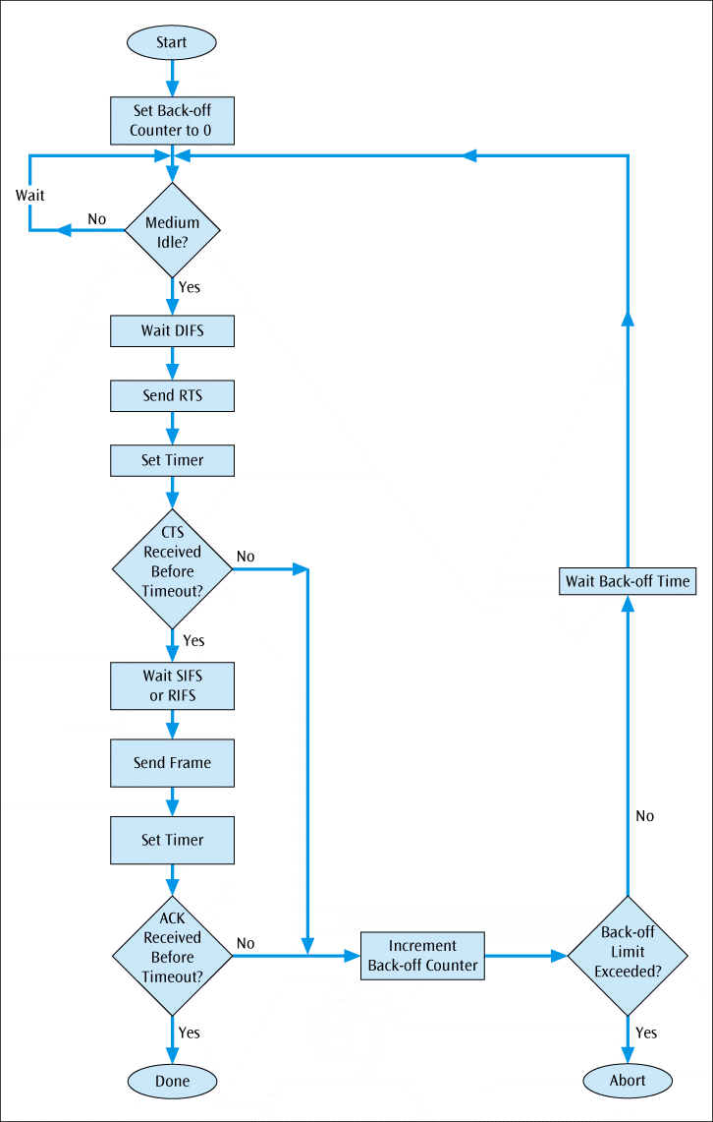
Figure 8-3
Flowchart showing the algorithm for CSMA/CA
Data Communications and Computer Networks: A Business User's Approach, Eighth Edition
© 2016. Cengage Learning. All Rights Reserved.

Slide 15
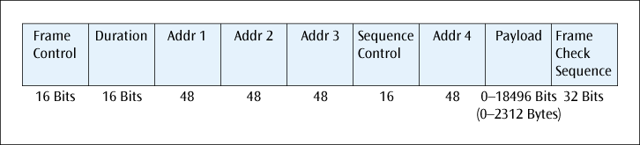
Wireless CSMA/CA
Note that the frame format for wireless Ethernet(CSMA/CA) has four address fields:
Figure 8-4
The various fields of the CSMA/CA frame
Data Communications and Computer Networks: A Business User's Approach, Eighth Edition
© 2016. Cengage Learning. All Rights Reserved.

Slide 16
LAN Support
Proper support of a local area network requires hardware, software, and miscellaneous support devices
Network OS is the most important software component
Numerous network support programs are also required to support users on a LAN
  Support devices such as hubs, switches, routers, servers, modems, power supplies, and more are also necessary
Data Communications and Computer Networks: A Business User's Approach, Eighth Edition
© 2016. Cengage Learning. All Rights Reserved.

Slide 17
Network Operating Systems
An OS manages all applications and resources in a computer
Multitasking OS supports execution of multiple processes at one time
Network OS is large, complex program that manages the resources common on most local area networks; client OS such as Windows 7 can perform some networking functions
Besides performing standard OS functions, a network OS is called upon for additional functions, such as:
Data Communications and Computer Networks: A Business User's Approach, Eighth Edition
© 2016. Cengage Learning. All Rights Reserved.

Slide 18
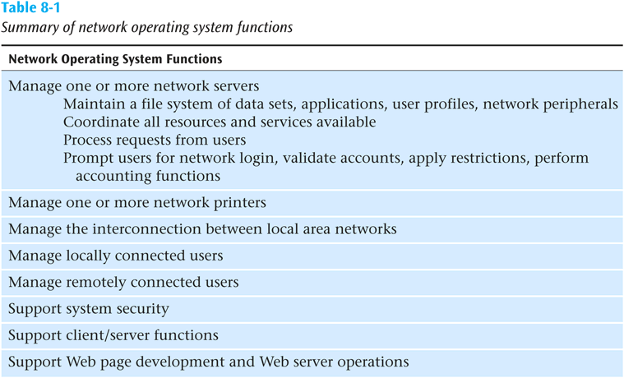
Network Operating Systems (continued)
Data Communications and Computer Networks: A Business User's Approach, Eighth Edition
© 2016. Cengage Learning. All Rights Reserved.

Slide 19
Current Network Operating Systems
Several popular network OSs currently exist:
  Windows Server family
  Unix
  Linux
  NetWare derivatives
Even though NetWare installations are now much fewer than any of the first three, NetWare is introduced first since it was the first to introduce the modern LAN directory structure
Data Communications and Computer Networks: A Business User's Approach, Eighth Edition
© 2016. Cengage Learning. All Rights Reserved.

Slide 20
Novell NetWare
At one time NetWare was the leading local area network OS
Has since fallen way down the list on number of installations and may even pass into oblivion some day
Nonetheless, it was NetWare that introduced a number of very powerful concepts, including the hierarchical directory structure
Data Communications and Computer Networks: A Business User's Approach, Eighth Edition
© 2016. Cengage Learning. All Rights Reserved.

Slide 21
Novell NetWare (continued)
Version 3 – popular but older version of Novell NetWare
  No longer supported by Novell (end of 2000)
  User logs onto a particular server
  Bindery maintains directory system
Version 4
  Unlike version 3 this version allows single network login
  Bindery replaced by powerful NDS database
  No longer supported by Novell (beginning of 2004)
Data Communications and Computer Networks: A Business User's Approach, Eighth Edition
© 2016. Cengage Learning. All Rights Reserved.

Slide 22
Novell NetWare (continued)
Version 5
  Allows administrator to use IP protocol instead of Novell’s proprietary IPX/SPX protocols
Data Communications and Computer Networks: A Business User's Approach, Eighth Edition
© 2016. Cengage Learning. All Rights Reserved.

Slide 23
Novell NetWare (continued)
Version 6
  Any client anywhere on the Internet can print and use storage services from NetWare 6 server without loading a single byte of Novell’s Client32 software
  Powerful Internet printing services (iPrint) make printing nearly idiot-proof
    User clicks on graphical image of floor plan showing printers; if user does not have printer driver, it is loaded automatically in background
Data Communications and Computer Networks: A Business User's Approach, Eighth Edition
© 2016. Cengage Learning. All Rights Reserved.

Slide 24
Novell NetWare (continued)
Version 6 (continued)
  iFolder
    Very effective background application powered by Apache Web Server to “equalize” the documents in each system’s My Documents folder with an identical set on the server
  Volumes can hold 8 terabytes of data in up to 8 trillion files and can keep 1 million files open concurrently
Data Communications and Computer Networks: A Business User's Approach, Eighth Edition
© 2016. Cengage Learning. All Rights Reserved.

Slide 25
Novell NetWare (continued)
Novell NDS (NetWare Directory Services)
  A database that maintains information on, and access to, every resource on the network, including users, groups of users, printers, data sets and servers
  Network administrator creates a hierarchical tree structure that represents the layout of the organization
  Tree structure is composed of organizational units which are composed of further objects, and leaf objects which are not composed of further objects
Data Communications and Computer Networks: A Business User's Approach, Eighth Edition
© 2016. Cengage Learning. All Rights Reserved.

Slide 26
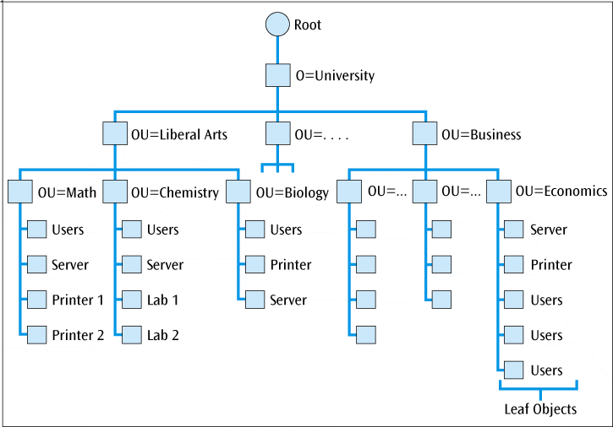
Novell NetWare (continued)
Figure 8-5
Possible design for a network operating system tree
Data Communications and Computer Networks: A Business User's Approach, Seventh Edition

Slide 27
Additional Suggestions for Designing a Network Tree
Hierarchical directory design
  Whether the NOS is NDS or Windows 2008, there are basic elements to designing a solid tree structure
  Some designers like to base the root of the tree on the company’s wide area network layout
  For example, the next slide breaks the root over three wide area locations
Data Communications and Computer Networks: A Business User's Approach, Eighth Edition
© 2016. Cengage Learning. All Rights Reserved.

Slide 28
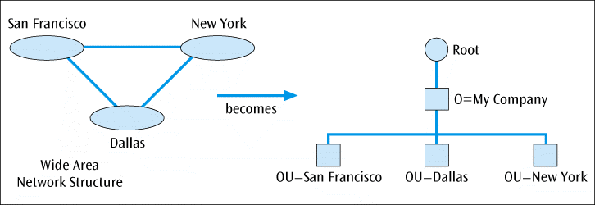
Additional Suggestions for Designing a Network Tree (continued)
Figure 8-6
Top level design based upon the corporate wide area network structure
Data Communications and Computer Networks: A Business User's Approach, Eighth Edition
© 2016. Cengage Learning. All Rights Reserved.

Slide 29
Additional Suggestions for Designing a Network Tree (continued)
Hierarchical directory design (continued)
  Once the wide area has been designed, you can break each city into the various departments
  Some designers like to break departments by their logical location, while others break departments by their physical location
Data Communications and Computer Networks: A Business User's Approach, Eighth Edition
© 2016. Cengage Learning. All Rights Reserved.

Slide 30
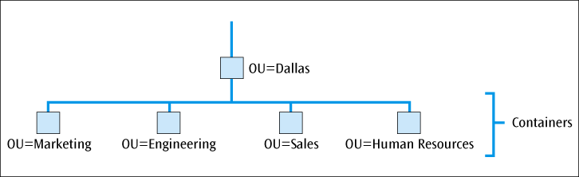
Additional Suggestions for Designing a Network Tree (continued)
Figure 8-7
Lower-level tree containers under the Dallas upper-level container
Data Communications and Computer Networks: A Business User's Approach, Eighth Edition
© 2016. Cengage Learning. All Rights Reserved.

Slide 31
Windows NT Version 4
User interface based on popular Windows OS
  Is NOT same as Windows 98
Full service multitasking OS capable of supporting multiple servers
NT systems worked very well with other Microsoft products
Questionable if NT can support large systems
Blue screen of death (BSOD) plagued NT systems
Data Communications and Computer Networks: A Business User's Approach, Eighth Edition
© 2016. Cengage Learning. All Rights Reserved.

Slide 32
Windows NT Version 4 (continued)
Domain
  Group of users, servers, and other resources that share account and security information
  May have from 1 to several hundred domains depending on size of system
Every domain has one and only one primary domain controller (PDC) (a server)
  Centrally manages account information and security
Each domain should have at least one backup domain controller (BDC) (a server)
Data Communications and Computer Networks: A Business User's Approach, Eighth Edition
© 2016. Cengage Learning. All Rights Reserved.

Slide 33
Windows NT Version 4 (continued)
Single domain model (Figure 8-4(a))
  Simplest Window NT model
  All users and resources are in one domain
Multiple domain model (Figure 8-4(b))
  Multiple domains, but no hierarchy
  Each domain is equal to all other domains
  To allow data to transfer between domains required the creation of trusts
Data Communications and Computer Networks: A Business User's Approach, Eighth Edition
© 2016. Cengage Learning. All Rights Reserved.

Slide 34
Windows NT Version 4 (continued)
Master domain model
  There is one domain model which provides a hierarchy, but the domains at the lower hierarchy cannot contain users, only resources
  Users in the main domain exert control over user accounts
Data Communications and Computer Networks: A Business User's Approach, Eighth Edition
© 2016. Cengage Learning. All Rights Reserved.

Slide 35
Windows 2000
Updated version of Windows NT network OS
Specific versions of 2000 designed to support wide variety of system types:
  Windows 2000 Professional
    Replaces NT Workstation
  Windows 2000 Server
    Replaces Windows NT Server
  Windows 2000 Advanced Server
    Supports up to 8 procs / 8GB
  Windows 2000 Datacenter Server
    Supports up to 32 processors and 64GB RAM
Data Communications and Computer Networks: A Business User's Approach, Eighth Edition
© 2016. Cengage Learning. All Rights Reserved.

Slide 36
Windows 2000 (continued)
Biggest change from NT is Active Directory (AD)
  AD is central repository for all objects that make up the enterprise: domains, organizational units, users, groups, computers, printers, etc.
  Roughly based on X.500 spec, creates a hierarchical tree
Data Communications and Computer Networks: A Business User's Approach, Eighth Edition
© 2016. Cengage Learning. All Rights Reserved.

Slide 37
Windows 2000 (continued)
At the top of hierarchical model is single forest of one or more trees, which must contain at least one (root) domain, which must contain at least one organizational unit (OU), and several other containers (See next slide)
Recommended size limitation of 1 million objects per domain, but lab tests have hit 10 million objects without failure
Data Communications and Computer Networks: A Business User's Approach, Eighth Edition
© 2016. Cengage Learning. All Rights Reserved.

Slide 38
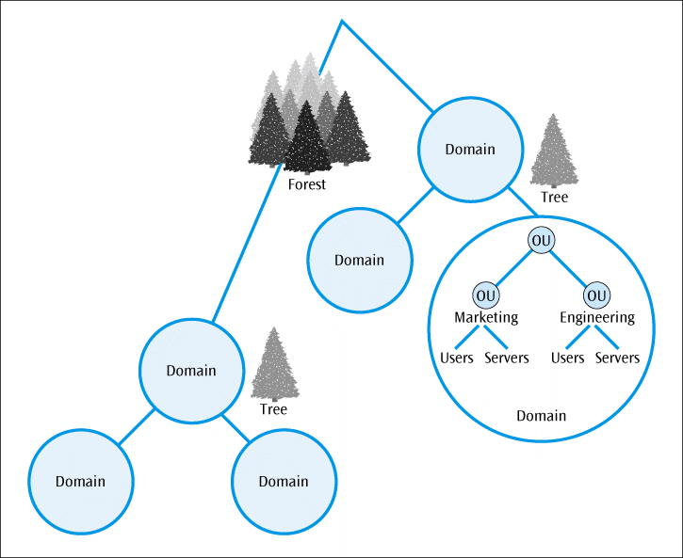
Windows 2000 (continued)
Figure 8-8
Example of a tree design of Windows Active Directory
Data Communications and Computer Networks: A Business User's Approach, Eighth Edition
© 2016. Cengage Learning. All Rights Reserved.

Slide 39
Windows 2000 (continued)
The domain has basically remained the same, but now you can have parent and child domains
  The parent and all its child domains are defined as a single domain tree, with multiple trees in the same AD a forest
Data Communications and Computer Networks: A Business User's Approach, Eighth Edition
© 2016. Cengage Learning. All Rights Reserved.

Slide 40
Windows 2000 (continued)
Domains are named in accordance with the Internet’s DNS standard RFCs 1034 and 1035
  For example, the root domain in a tree could be called bigcompany.com
  The marketing child domain could be mktg.bigcompany.com
  The production child domain could be prod.bigcompany.com
As in NT, you can create trusts between parent and child domains
  Only with 2000 the trust can be transitive
Data Communications and Computer Networks: A Business User's Approach, Eighth Edition
© 2016. Cengage Learning. All Rights Reserved.

Slide 41
Windows 2003
Improvements to Active Directory, including new management tools
Capability to interconnect up to 8 Windows servers
New and improved file and print support services
Support for IPv6
Security improvements
Data Communications and Computer Networks: A Business User's Approach, Eighth Edition
© 2016. Cengage Learning. All Rights Reserved.

Slide 42
Windows 2012
The latest version of Windows network OS
Continued improvements to Active Directory, including new management tools
New server core (including a virtual server)
Self-healing server that can fix corrupted files and/or folders
Increased processing speed
Advancements in network security
Data Communications and Computer Networks: A Business User's Approach, Eighth Edition
© 2016. Cengage Learning. All Rights Reserved.

Slide 43
Unix
Well established and very popular multitasking OS capable of supporting network operations
First OS written in the language C
Very stable system capable of supporting very large operations
Numerous versions available from different vendors
Data Communications and Computer Networks: A Business User's Approach, Eighth Edition
© 2016. Cengage Learning. All Rights Reserved.

Slide 44
Linux
OS based on the principles of Unix.
Many versions available for free (Free Software Foundation’s GNU toolset) or very small price
Very stable multitasking OS
When incorporated with other free software products, such as the Apache Web server and Atipa’s BlueBird network management software, this system becomes extremely cost effective and powerful
Data Communications and Computer Networks: A Business User's Approach, Eighth Edition
© 2016. Cengage Learning. All Rights Reserved.

Slide 45
Novell Linux
Novell, seeing that its market share of NetWare was eroding, moved into the Linux market in the early 21st century
  Novell currently offers a number of versions of Linux, including high-power servers and desktop OSs
Data Communications and Computer Networks: A Business User's Approach, Eighth Edition
© 2016. Cengage Learning. All Rights Reserved.

Slide 46
Mac OS X Server
Apple Computer finally joined the NOS market with its Mac OS Server
Version X is based on Linux code
  Very stable and quite powerful
While installed primarily in Apple networks, Mac OS X Server is also capable of supporting non-Apple networks
Data Communications and Computer Networks: A Business User's Approach, Eighth Edition
© 2016. Cengage Learning. All Rights Reserved.

Slide 47
Network Servers
In order to support a network OS, you need one or more network servers
  Network servers are high-power workstations often with multiple processors, RAID, SCSI, and lots of memory and disk space
  Various forms of servers include server appliances, and server blades
Server virtualization allows you to create multiple servers in software all running on a single physical server
Data Communications and Computer Networks: A Business User's Approach, Eighth Edition
© 2016. Cengage Learning. All Rights Reserved.

Slide 48
Network Servers (continued)
To protect the server from catastrophic disk failure, disk drives on most network servers support one of the redundant array of independent disks (RAID) techniques
  RAID is a collection of techniques for interfacing multiple hard disk drives to a computer
Data Communications and Computer Networks: A Business User's Approach, Eighth Edition
© 2016. Cengage Learning. All Rights Reserved.

Slide 49
Network Servers (continued)
Some of the more common RAID techniques include:
  RAID-0
    Data is broken into pieces, and each piece is stored on different disk drives
      This technique is known as striping.
  RAID-1
    Data is stored on at least two disk drives, in duplicate, to provide a level of redundancy (or fault tolerance), should one disk become corrupted
      This technique is known also as disk mirroring
Data Communications and Computer Networks: A Business User's Approach, Eighth Edition
© 2016. Cengage Learning. All Rights Reserved.

Slide 50
Network Servers (continued)
Some of the more common RAID techniques include (continued):
  RAID-3
    Data is redundantly stored across multiple disk drives (striping), and error-checking information concerning the stored data is kept on a separate disk
  RAID-5
    Data is broken into pieces (stripes) and stored across three or more disks
    Parity information (error-checking code) is stored along with the striped data, not on a separate disk
    RAID-5 is the most popular of the RAID techniques
Data Communications and Computer Networks: A Business User's Approach, Eighth Edition
© 2016. Cengage Learning. All Rights Reserved.

Slide 51
Client/Server Networks vs. Peer-to-Peer Networks
A clear majority of LANs are client/server networks
A client/server network has one or more network servers supporting the operations of one or more clients, or user workstations
Peer-to-peer networks also exist
  May have servers, but the network relies less on the servers and more on the communications between workstations
Data Communications and Computer Networks: A Business User's Approach, Eighth Edition
© 2016. Cengage Learning. All Rights Reserved.

Slide 52
Network Support Software
In order to support a network OS, may also need:
  Utilities
  Internet software
Data Communications and Computer Networks: A Business User's Approach, Eighth Edition
© 2016. Cengage Learning. All Rights Reserved.

Slide 53
Utilities
Eight of the more common groups of network utility software include:
  Antivirus software
  Anti-spam software
  Anti-spyware software
  Backup software
  Network-monitoring software
  Crash protection software
  Security assessment software
  Remote access software
  Uninstall software
Data Communications and Computer Networks: A Business User's Approach, Eighth Edition
© 2016. Cengage Learning. All Rights Reserved.

Slide 54
Internet Software
Software necessary to support server side of Internet connections
Retrieves Web pages and other documents when asked to by a client workstation
Can interface with database program allowing users to store and retrieve data via Internet
Necessary with commercial Internet applications
Data Communications and Computer Networks: A Business User's Approach, Eighth Edition
© 2016. Cengage Learning. All Rights Reserved.

Slide 55
Software Licensing Agreements
Virtually every commercial software program comes with a specific licensing agreement
Most licensing agreements specify the following conditions:
  Software installation and use
  Network installation
  Backup copies
  Decompilation
  Rental statement
  Upgrade availabilities
  Copyright restrictions
  Maintenance agreements
Data Communications and Computer Networks: A Business User's Approach, Eighth Edition
© 2016. Cengage Learning. All Rights Reserved.

Slide 56
Software Licensing Agreements (continued)
Most licensing agreements come in one of the following forms:
  Single-user-single-station license
  Single-user-multiple-station license
  Interactive user license
  Network server license
  Site license
  Corporate license
Data Communications and Computer Networks: A Business User's Approach, Eighth Edition
© 2016. Cengage Learning. All Rights Reserved.

Slide 57
LAN Support Devices
Other devices necessary for the proper support of a LAN:
  Uninterruptible power supplies (UPS)
  Tape drives
  Printers
  Media converters
  Workstations (including thin client workstations)
Data Communications and Computer Networks: A Business User's Approach, Eighth Edition
© 2016. Cengage Learning. All Rights Reserved.

Slide 58
LAN Software In Action: A Small Company Makes a Choice
Hannah asks the following questions:
  What are the primary uses (applications) of the current system?
    Some applications work better (or only) with a specific NOS
  How would the choice of a particular NOS affect maintenance and support?
Data Communications and Computer Networks: A Business User's Approach, Eighth Edition
© 2016. Cengage Learning. All Rights Reserved.

Slide 59
LAN Software In Action: A Small Company Makes a Choice (continued)
Hannah asks the following questions (continued):
  Are finances an issue in the selection of a NOS?
    Linux offers an extremely attractive cost
  Does the existing system have any unusual hardware or software that might influence the NOS choice?
  Will the network be located in a single location or in multiple locations?
    NDS is easier to maintain from remote locations
  Are there any political pressures to select a particular NOS?
Data Communications and Computer Networks: A Business User's Approach, Eighth Edition
© 2016. Cengage Learning. All Rights Reserved.

Slide 60
LANs In Action: A Home Office Solution
Sam has three computers at home and wants all three to share a printer and a connection to the Internet
What are some of the questions that Sam has to answer before he can start purchasing and/or installing something?
Data Communications and Computer Networks: A Business User's Approach, Eighth Edition
© 2016. Cengage Learning. All Rights Reserved.

Slide 61
Wireless Networking In Action: Creating a Wireless LAN for Home
Many decisions to make when installing a wireless LAN
  Which IEEE 802.11 format?
    802.11a?
      Fast (54 Mbps), uses higher frequencies
    802.11g?
      Fast (54 Mbps), compatible with 802.11b
    802.11n or ac?
      Latest standards (100+Mbps)
Data Communications and Computer Networks: A Business User's Approach, Eighth Edition
© 2016. Cengage Learning. All Rights Reserved.

Slide 62
Wireless Networking In Action: Creating a Wireless LAN for Home (continued)
Many decisions to make when installing a wireless LAN (continued)
  What type of wireless access point do you need?
    If you already have a wired network (with router and modem), all you need is a basic wireless access point
    If you don’t have a home network but have a high-speed Internet connection, you will need a wireless router
    If you don’t even have a high-speed Internet connection yet, you might want to consider a wireless gateway.
Data Communications and Computer Networks: A Business User's Approach, Eighth Edition
© 2016. Cengage Learning. All Rights Reserved.

Slide 63
Wireless Networking In Action: Creating a Wireless LAN for Home (continued)
Many decisions to make when installing a wireless LAN (continued)
  What type of network OS do you need?
    Do you need something as powerful as Windows 2012 Server?
      No, you only need a client OS such as latest Windows desktop OS, Apple Mac OS, or Linux
Data Communications and Computer Networks: A Business User's Approach, Eighth Edition
© 2016. Cengage Learning. All Rights Reserved.

Slide 64
Summary
Wireless Ethernet (or CSMA/CA) is a very popular LAN layout and continues growing every day
There are a number of popular technologies for Wireless Ethernet, including IEEE 802.11a and IEEE 802.11g (54 Mbps theoretical) and IEEE 802.11n and ac(100 Mbps theoretical)
The CSMA/CA access protocol no longer detects collisions but has a number of operations which try to avoid collisions before they can happen
Data Communications and Computer Networks: A Business User's Approach, Eighth Edition
© 2016. Cengage Learning. All Rights Reserved.

Slide 65
Summary
A network OS has several additional functions not normally found in an OS
Novell NetWare was a network operating system with a powerful directory service (NDS)
  Very good at performing file and print serving
Windows NT was an older network OS
  Very good at supporting client/server applications
  Based on the domain
Windows Server family represents significant advancement over NT
  Includes powerful directory service, Active Directory
Data Communications and Computer Networks: A Business User's Approach, Eighth Edition
© 2016. Cengage Learning. All Rights Reserved.

Slide 66
Summary (continued)
Unix is a mature operating system that is stable, fast, and capable of running on a variety of platforms
Linux is a derivative of Unix
Mac OS X Server is another derivative of Unix
A network server is computer that stores software resources and either allows or denies workstations connected to network access to these resources
Many network servers can perform one or more levels of RAID
Data Communications and Computer Networks: A Business User's Approach, Eighth Edition
© 2016. Cengage Learning. All Rights Reserved.

Slide 67
Summary (continued)
Many types of software programs support a LAN
  These include utility programs and Internet software tools
Software licensing agreements are an important part of LAN software installation
Many types of hardware devices are necessary to support a LAN
Data Communications and Computer Networks: A Business User's Approach, Eighth Edition
© 2016. Cengage Learning. All Rights Reserved.

